Slide 1
Statistical theory of molecular solutions with complex electric structure
Yury A. Budkov
MIEM HSE and ISC RAS

Slide 2
The deficiencies of the “local” theories of polar fluids
Within the local theory:
It is impossible to obtain the dependence of electrostatic potential of point-like charge in the dipole environment at the distances order of the dipolar length scale. Knowing this dependence is very relevant for solutions of particles with giant dipole moments (200-1000 D), such as proteins!
The ultraviolet divergence of the electrostatic free energy of polar fluid takes place [Levy et al., Phys. Rev. Lett., 2012]. There is an arbitrariness with choice of the ultraviolet cut-off.

Slide 3
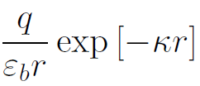
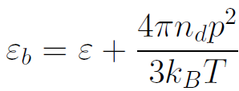
Electrostatic free energy and potential of point-like charge in local theory

Slide 4
Motivation
The recent advances in experimental studies of different organic compounds (such as proteins, betaines, zwitterionic liquids, etc) comprising rather long dipole length (5–20 nm) challenged the statistical mechanics to develop the analytical approaches to modeling the dipolar particles not as the point-like dipolar particles (or even as the dipolar hard spheres), but as a set of charge centers with fixed or fluctuating distances between them. One would expect that such a nonlocal theory should be devoid of the mentioned ultraviolet divergence of the free energy and allow us to study the electrostatic potential behavior at the distances from the point-like test charge that are comparable to the characteristic distances between the charge centers of the dipolar particle.
Yury A. Budkov 2018 J. Phys.: Condens. Matter (Emerging leaders 2018)

Slide 5
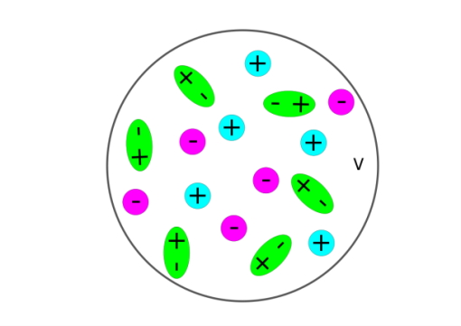
Basic idea of approach
To formulate a statistical theory of electrolyte solution with admixture of small quantity of dipolar particles with rather big dipole moment. In contrast to the local theory [Levy et al., Phys. Rev. Lett., 2007], we model the every dipolar particle as a dimer with fixed or fluctuating distance between their polar groups. We associate with each dipolar particle the probability distribution function g(r) of distance between their polar groups.
g(r) – probability distribution function of distance between
polar groups

Slide 6
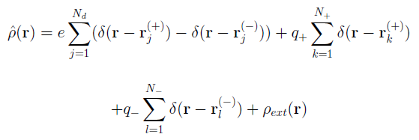
Configuration integral of ion-dipole mixture in the functional integral form
- density of some external charges

Slide 7
Hubbard-Stratonovich transformation

Slide 8
Using the Hubbard-Stratonovich transformation, we obtain:
- one-particle partition functions
- normalization constant of Gaussian measure
In the thermodynamic limit we obtain:

Slide 9
Connection with PBL theory
For the polar particles with fixed dipolar length the distribution function is:
Abrashkin et al., Phys. Rev. Lett., 2007
Coalson et al, J. Phys. Chem., 1996

Slide 10
Mean-field approximation
Modified Poisson-Boltzmann equation
Electrostatic free energy in the mean-field approximation is

Slide 11
Point-like charge in dipole environment
Placing the point-like charge at the origin and taking into account that
In the case of weak electrostatic interactions, i.e. when , we have
The solution takes the form:

Slide 12
One can formally introduce the local dielectric permittivity :
- effective solvation radius of ion

Slide 13
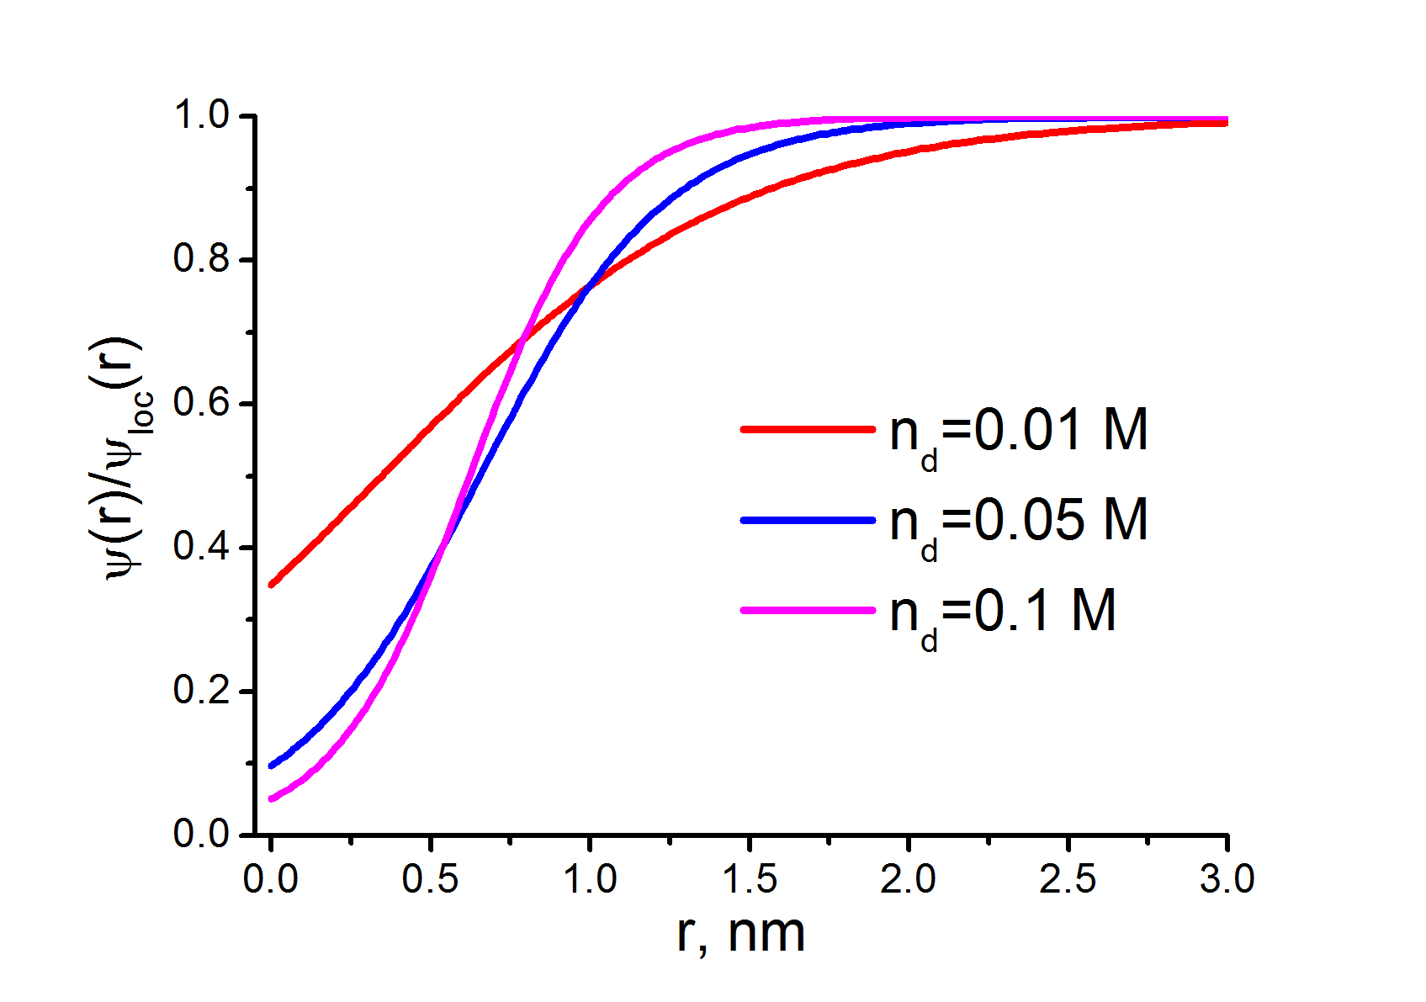
Comparison with local theory

Slide 14
Point-like charge in ion-dipole environment
In presence of ions we have the following linearized equation
- ionic strength
In that case we have

Slide 15
Gaussian approximation for electrostatic free energy
For the bulk solution we have:
In the absence of ions one can obtain the analytic expression for free energy ( ):

Slide 16
We have the following limiting regimes:
- Keesom regime
- Debye-Hueckel regime
Limiting regimes for the free energy in presence of ions
At y_{d} << 1 we obtain:
At y_{d} >>1 we obtain the Debye-Hueckel limiting law:
Polar groups of the dipolar particles with very long dipole length can be considered as unbonded ions.

Slide 17
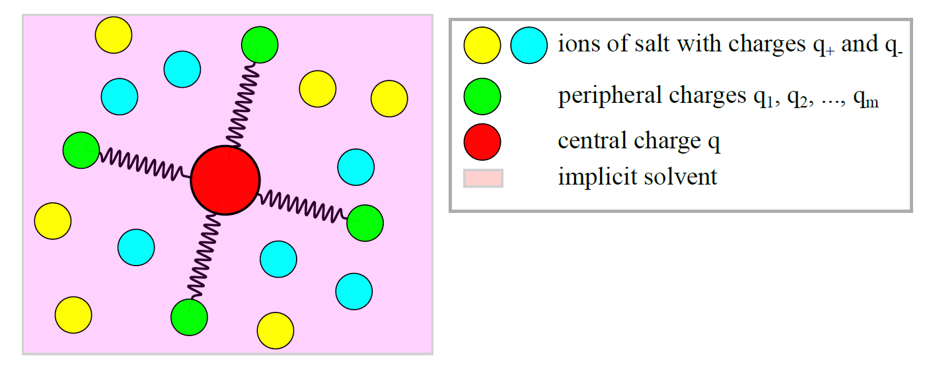
Generalization for multipolar particles
Budkov 2019 J. Phys.: Condens. Matter to be published (http://arxiv.org/abs/1909.02319)

Slide 18
Mean-field potential in linear approximation and screening function
- dielectric function
For the case of identical peripheral charges, when

Slide 19
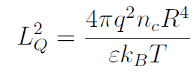
Potential of point-like charge at long distances
- square of ‘quadrupolar’ length
In the direct space in the linear approximation we have the following equation:
Slavchov J. Chem. Phys., 2014

Slide 20
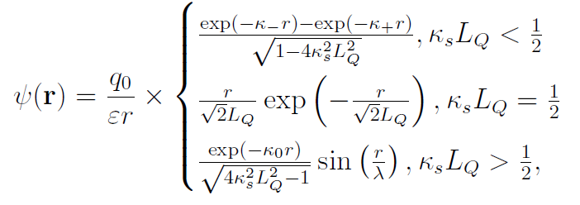
Potential of point-like charge at long distances
Budkov, J. Phys.: Cond. Matt., 2019, to be published
M. E. Fisher and B. Widom 1969 J. Chem. Phys.

Slide 21
Electrostatic free energy
For salt-free case we have:
Limiting regimes for electrostatic free energy:
- regime of van der Waals gas
- regime of one-component plasma

Slide 22
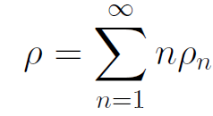
Theory with dipole association
A₁
A₁
K
A₂
+
=
A_{n}+A₁=A_{n+1}
Budkov, Journal of Molecular Liquids, 2019

Slide 23
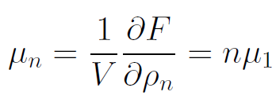
Electrostatic free energy

Slide 24
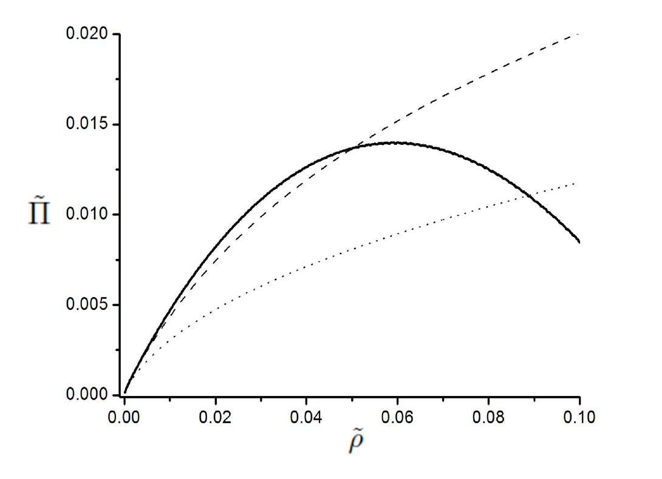
Total free energy and thermodynamic stability

Slide 25
Potential of point-like charge

Slide 26
Theory with repulsive interactions
Budkov, Fluid Phase Equilibria, 2019

Slide 27
Thermodynamic perturbation theory

Slide 28
General theory of polar molecules

Slide 29
Theory of soft-core dipolar particles
(Zubarev, 1954)

Slide 30
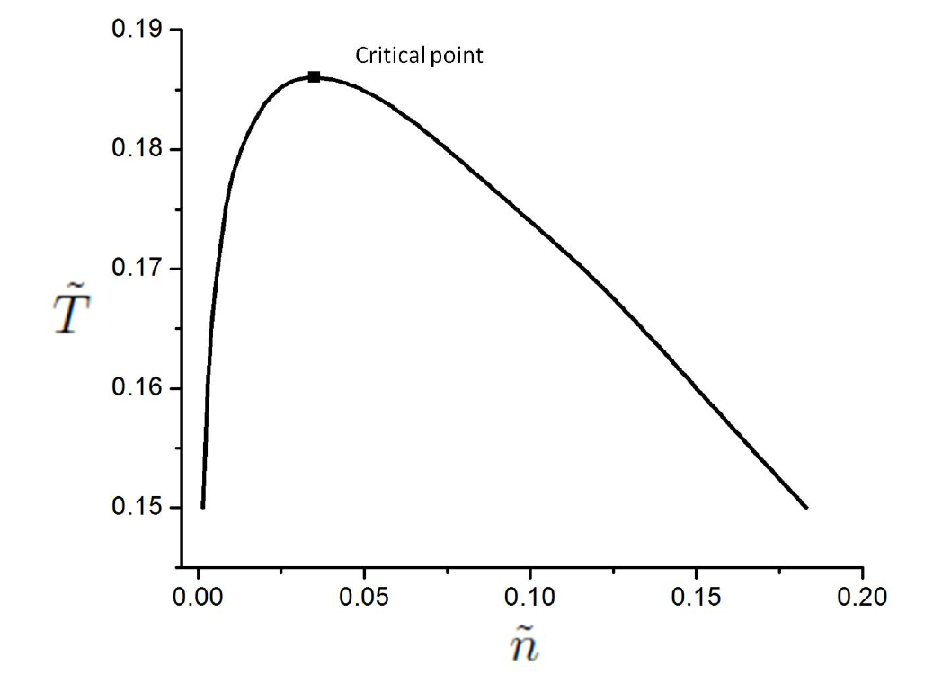
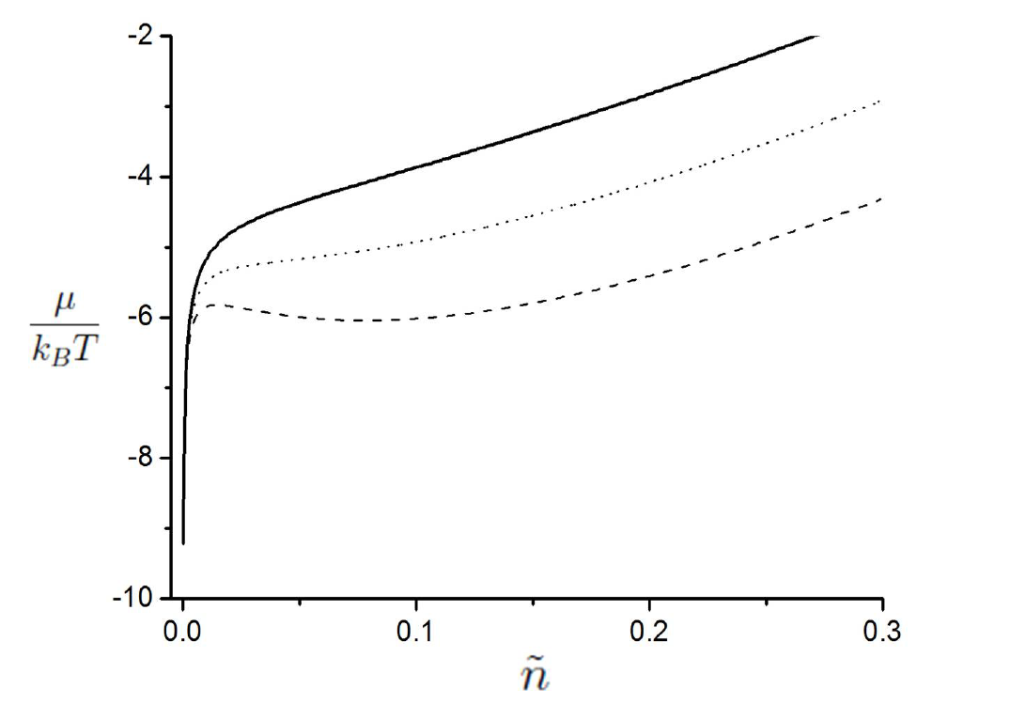
Gaussian core dipolar model: Liquid-liquid phase separation
At sufficiently small temperatures a fluid-fluid phase separation takes place

Slide 31
Conclusions
We have developed a systematic nonlocal statistical field theory of salt solutions of dipolar particles without ultraviolet divergences.
We have generalized “dipolar” theory for the case of neutral multipolar particles and predicted new crossover from monotonic decrease of electrostatic potential of point-like charge to its damped oscillations.
We have developed a nonlocal field theory of dilute solutions of the dipolar particles, which are capable of forming chain-like clusters in accordance with the “head-to-tail” mechanism. We have confirmed conclusion, made earlier from computer simulations that formation of chain-like clusters can stabilize solution, preventing its phase separation.
We have developed a general field theory of solutions of the molecules with an arbitrary internal electric charge distribution and applied it to analyzing phase behavior of solutions of soft-core dipolar particles.

Slide 32
Prospects
To investigate a phase behavior of dipolar particles solutions taking into account association, van der Waals, and steric (excluded volume) interactions.
To confirm by computer simulations the oscillations of electrostatic potential, immersed in a salt solution of multipolar colloid particles.
To confirm a fluid-fluid phase separation in solutions of soft-core dipolar particles by computer simulations. The latter is important for solutions of intrinsically disordered proteins.

